Slide 1


CMR TECHNICAL CAMPUS UGC (Autonomous) Kandlakoya, Medchal Road, Hyd-501 401 Department of Computer Science & Engineering Real Time Project Review TITLE OF THE PROJECT
Voice Based Heartbeat Monitoring System For Elder People
BATCH NO :04
Project Guide : ROLL NUMBERS :
Name: Dr. K. Srujan Raju Roll No – Name of the Student
Designation: HOD-CSE
Project Coordinator : 227R1A0506-Ankit Kumar Pandey
Name: Mr. Srinu Vandanapu 227R1A0530-K. Radha
Designation: Assistant Professor 227R1A0555-S. Anjitha Reddy

Slide 2
CONTENTS
Abstract
Introduction
Literature Survey
Proposed Methodology
Implementation and Architecture
Result and Discussion
Conclusion and Future Scope
References

Slide 3
ABSTRACT
In this occupied and rivalry world we can't checking our seniors (matured individuals) and patients persistently despite the fact that we have such an extensive amount love on them.
By utilizing progressions in present innovations we are building up this concept to save time and easy to understand framework. Our main motive is to monitor the health conditions of patient’s continuously.

Slide 4
INTRODUCTION
Large numbers of preventable deaths occur in hospitals each year, due to adverse events such as cardiac arrest and unplanned admission into Intensive Care Units (ICUs) from other hospital wards.
The majority of these patients exhibit physiological deterioration in their vital signs prior to onset of the adverse event, which can be detected by this project.
One of the ideal ways of using technology is to sense serious health problems so that efficient medical services can be provided to the patient in correct time.
This project uses regulated 5V, 500MA power supply, 7805 three terminal voltage regulator is used for voltage regulation.
Bridge type full wave rectifier is used to rectify the ac output of secondary of 230/12V step down transformer.

Slide 5
LITERATURE SURVEY
IoT technology's role in remote health monitoring.
Wearable devices' accuracy in heart rate monitoring.
Voice user interfaces' potential in healthcare applications.
User-centered design for elderly health monitoring systems.

Slide 6
PROPOSED METHODOLOGY
Giving power supply to device.
Connecting Bluetooth device with our phone.
Continuous monitoring of patient.
Get voice based message if heart beat goes above a set level.
HARDWARE USED:
Microcontroller (AT89S52)
LCD Display
Electro magnetic Pulse Rate Sensor
Bluetooth Device
SOFTWARE USED:
Kiel U Vision
Embedded C
ISP(Internet Service Provider)

Slide 7
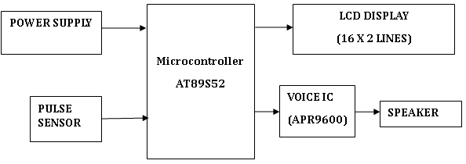
IMPLEMENTATION & ARCHITECTURE

Slide 8
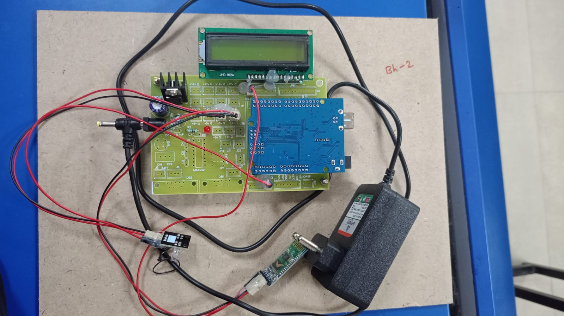
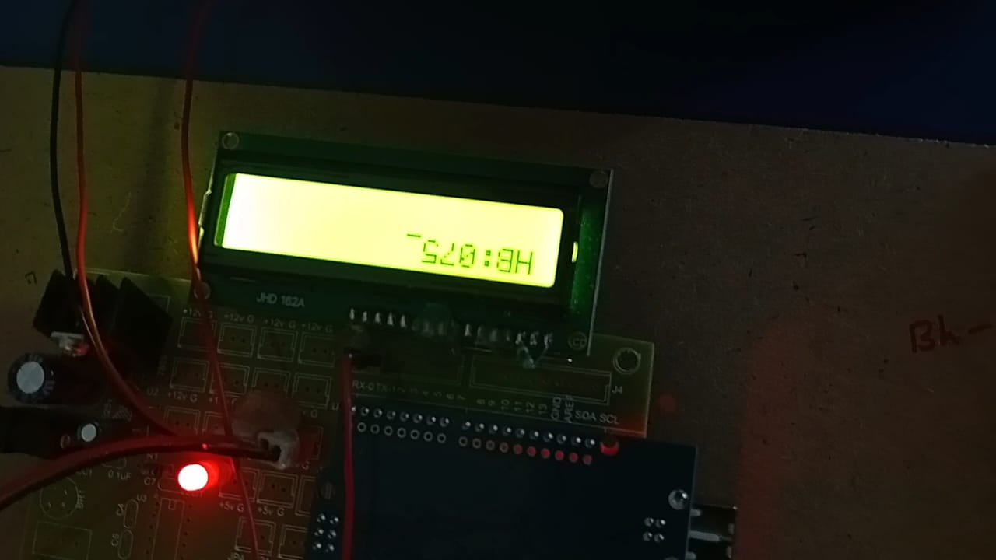
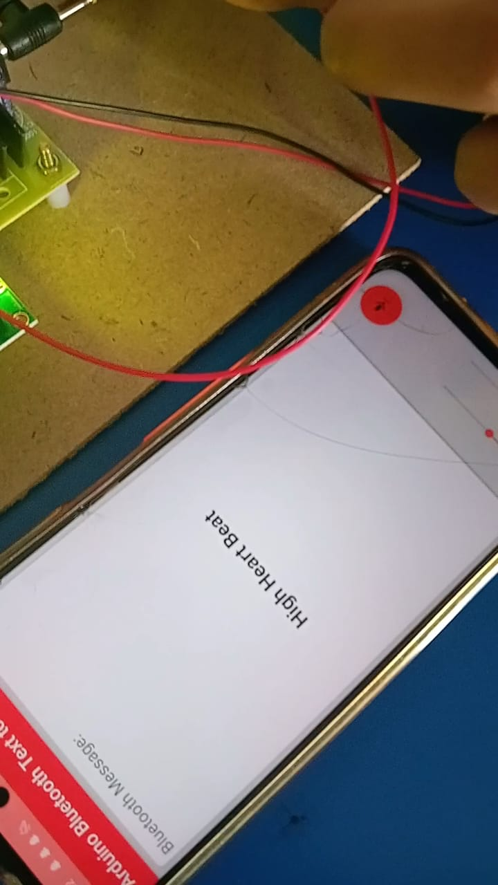
LCD DISPLAY
MICRO CONTROLLER
BLUETOOTH
ELECTRO MANGNETIC PULSE SENSOR
POWER SUPPLY
When heart beat reaches 75 the output is shown as below:

Slide 9
RESULTS & DISCUSSION
In this project we can monitor the Heart beat and produces voice based alerts when necessary.
Validates the system's reliability; highlights areas for improvement, such as reducing noise interference.
Emphasizes the importance of user-friendly design and the non-intrusive nature of the system, with suggestions for further enhancements.
Demonstrates the system's potential to improve remote patient monitoring and healthcare efficiency, addressing integration challenges.

Slide 10
CONCLUSION AND FUTURE SCOPE
High Accuracy and Reliability: The voice-based heartbeat monitoring system demonstrated high accuracy in detecting heartbeats.
Positive User Experience: Elderly participants found the system easy to use and non-intrusive, highlighting its user-friendly design and accessibility.
Algorithm Enhancement: Future work should focus on refining signal processing and heartbeat detection algorithms to further improve accuracy.
Extended Clinical Trials: Conducting larger-scale and longer-term clinical trials will help validate the system’s effectiveness across diverse populations

Slide 11
REFERENCES
Lee, J. H., & Park, K. S. (2017). Development of a non-invasive heartbeat monitoring system using smartphones. Journal of Medical Systems, 41(6), 101.
Jiang, F., & Jin, X. (2019). Heartbeat detection and monitoring based on mobile phone embedded system. Journal of Physics: Conference Series, 1234(1), 012345.
Jiang, W., & Zhang, Y. (2020). Voice-based heartbeat monitoring using convolutional neural networks. IEEE Access, 8, 115485-115493.
Chen, X., & Chen, J. (2021). Design and implementation of a voice-based heartbeat monitoring system. International Journal of Engineering and Technology, 13(3), 236-242.

Slide 12
Q&A

Slide 13
THANK YOU

